Slide 1
Chapter 4

Slide 2
Objectives

Slide 3
Objectives (continued)

Slide 4
Another method of the window object that displays a dialog box

Slide 5
Two methods of the window object for working with numbers

Slide 6
Examples of window methods

Slide 7
Three methods of the document object

Slide 8
Examples of document methods

Slide 9
Terms

Slide 10
Members of the Textbox object

Slide 11
HTML tags that define two text boxes

Slide 12
How to use the value property to get the value from a text box

Slide 13
How to use the parseFloat method to get a number value from a text box

Slide 14
Other examples of chaining

Slide 15
How to create a JavaScript object

Slide 16
A few of the methods of a Date object

Slide 17
Properties and methods of a String object

Slide 18
The code for a web page

Slide 19
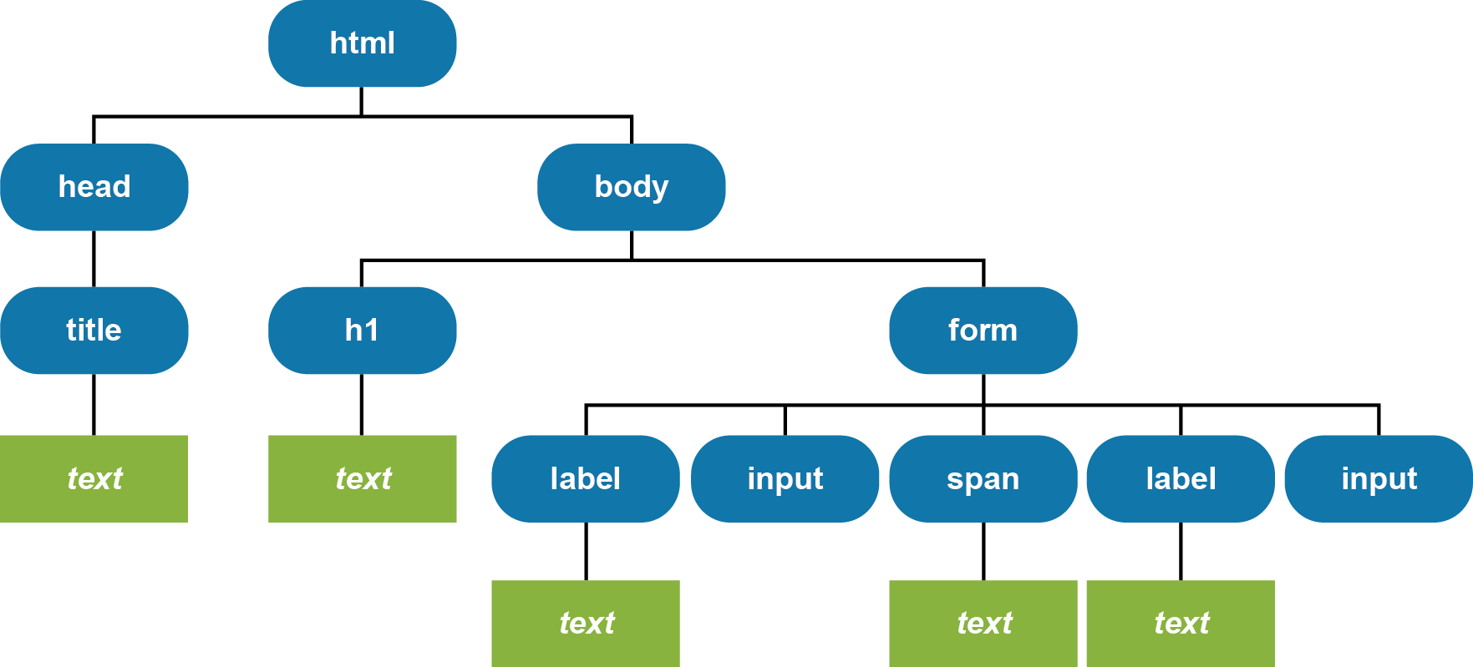
The DOM for the web page

Slide 20
The syntax for changing the text node for an element

Slide 21
Terms

Slide 22
The syntax for a function expression

Slide 23
A function expression with one parameter that returns a DOM element

Slide 24
A function expression with no parameters that doesn’t return a value

Slide 25
A function expression with two parameters that returns a value

Slide 26
The syntax for a function declaration

Slide 27
A function declaration with two parameters that returns a value

Slide 28
A function declaration with two parameters that returns a value

Slide 29
Terms

Slide 30
A function that uses a local variable named tax

Slide 31
A function that uses a global variable named tax

Slide 32
A function that inadvertently uses a global variable named tax

Slide 33
Best coding practices for variables

Slide 34
Terms

Slide 35
Common events

Slide 36
The syntax for attaching an event handler

Slide 37
How to attach the event handler to the click event of a button

Slide 38
Terms

Slide 39
The HTML for a page

Slide 40
JavaScript that attaches two event handlers in the onload event handler

Slide 41
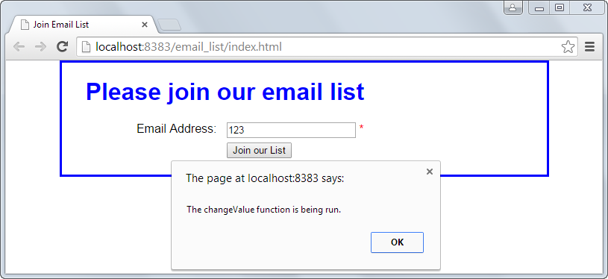
The web browser after the Email Address has been changed

Slide 42
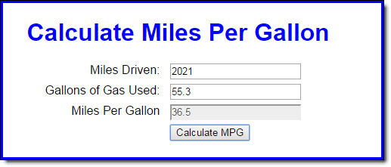
The Miles Per Gallon application in a browser

Slide 43
The HTML and JavaScript for the application

Slide 44
The HTML and JavaScript (continued)

Slide 45
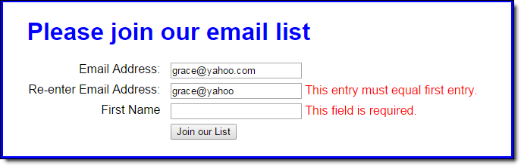
The Email List application in a web browser

Slide 46
The HTML file for the page

Slide 47
The HTML file for the page (continued)

Slide 48
The JavaScript for the Email List application

Slide 49
The JavaScript (continued)

Slide 50
The JavaScript (continued)

Slide 51
Exercise 4-1 Enhance the MPG application

Slide 52

Exercise 4-2 Build a new Future Value app

Slide 53
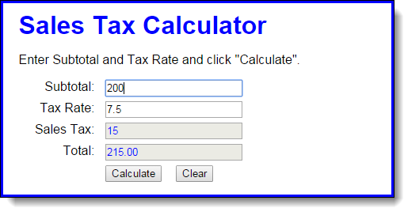
Extra 4-1 Develop the Sales Tax Calculator

Slide 54
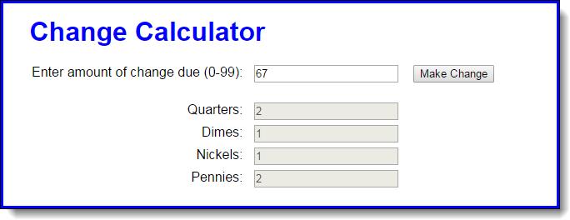
Extra 4-2 Develop the Change Calculator

Slide 55
Extra 4-3 Develop the Income Tax Calculator

Slide 56
Short 4-1 Enhance the MPG application

